Slide 1

Introduction to Locomotor & Multiple Disabilities-4
Unit 4: Deaf-Blindness

Slide 2
Unit 4: Deaf-Blindness
Definition, causes, classification, prevalence and characteristics of deaf-blindness
Effects and implications of deaf-blindness on activities of daily living & education
Screening, assessment, identification & interventional strategies of deaf-blindness
Fostering early communication development: Methods, assistive devices and practices including AAC
Addressing orientation, mobility and educational needs of students with deaf-blindness

Slide 3
Unit 4: Deaf Blindness
Definition, causes, classification, prevalence and characteristics of deaf-blindness
Effects and implications of deaf-blindness on activities of daily living & education
Screening, assessment, identification & interventional strategies of deaf-blindness
Fostering early communication development: Methods, assistive devices and practices including AAC
Addressing orientation, mobility and educational needs of students with deaf-blindness

Slide 4
Early Communication…
Communication efforts begin right from birth
  Aroused by needs physical and/or emotional comfort
  Expressed through a variety of means
    Crying
    Cooing
    Babblling & other vocalisations
    Facial expressions / grimaces
    Body postures & movements
    Specific behaviours – like hugging or clinging to persons, throwing objects
  Later they learn to observe & learn from adult ways of communication trial imitation & feedback

Slide 5
…Early Communication…
Early communication in young deaf-blind children very limited b’cos –
  They receive limited stimulation & information from the environment that are necessary for
    Perception & cognition of persons, objects & events around
    Anticipation of interaction with persons, objects & events
    Development of preferences & reactions to persons, objects & events
    Efforts to communicate their needs, preferences, ideas, information & emotions
  In many instances their basic needs are fulfilled without need for communication
  They do not get to see other human behaviours
      speech sounds that are heard
      facial expression & body language that are visually observed
  Thus, they are –
    Minimally stimulated to communicate on their own
    Unable to communicate comprehensible and/or socially inappropriate ways
  Limited communication & fragmented information → isolation

Slide 6
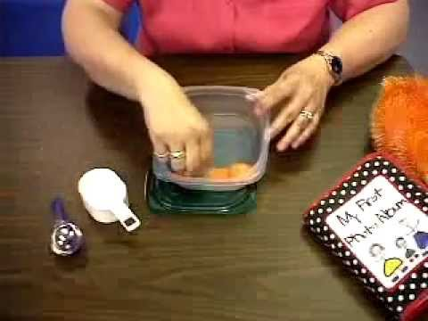
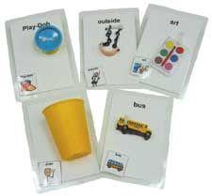
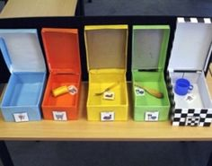
…Early Communication…
Early communication training for deaf-blind children
  Step 1: Foundation of Concepts
    Exposure to real person, objects or events
    Expand with associated persons, objects & events
    Introduction of object cues & tangible symbols that represent them
  Step 2: Enable Communication (about learnt concepts)
    With help of object cues & tangible symbols
    With partial object or associated object clues
    Extended representation with tactual, visual, auditory and/or other sensory stimuli
    Calendar system of anticipated / accomplished activities
    Inculcation of socially appropriate communication behaviours – choice-making, turn-taking, socialisation, problem-solving

Slide 7
…Early Communication…
Process of Communication
Anticipation
Motivation
Communication
Confirmation

Slide 8
…Early Communication
In the process of development of early communication skills, need to develop –
  Create efforts to initiate & anticipate
  Provide choice of subject matter, activities & modes
  Maintain dual participation & dynamicity
  Create a conducive environment – with all significant others involved
  Familiarise with all persons/participants, objects & settings in the environment for communication
  Ensure physically safe environment & sense of security in deaf-blind learner
  Allow of sue of augmentative / assistive and/or alternate modes of communication

Slide 9
Assistive Devices & Practices in Communication…
Augmentative or Alternative Communication – AAC
  Any manual or electronic communication system that helps individuals to –
    Express wants or desires
    Share information
    Engage in social interaction
  By supplementing or substituting the usual human communication processes

Slide 10
…Assistive Devices & Practices in Communication…
Types
Electronic
Manual-Visual
Tactile-Manual
Tactile
Verbal-Visual
Hi-Tech
Low Tech

Slide 11
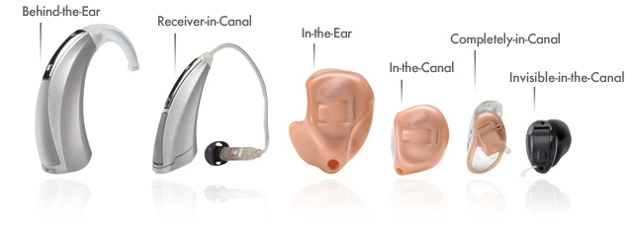
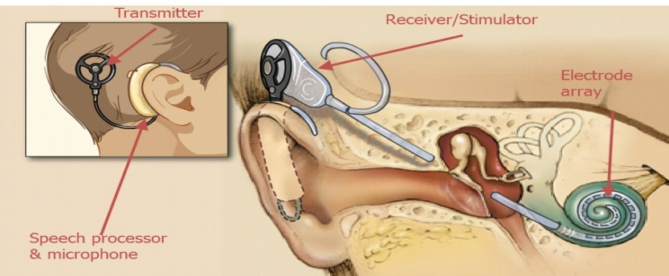
…Assistive Devices for Communication…
Devices to maximise use of residual hearing
  Sound processors & amplifiers

Slide 12
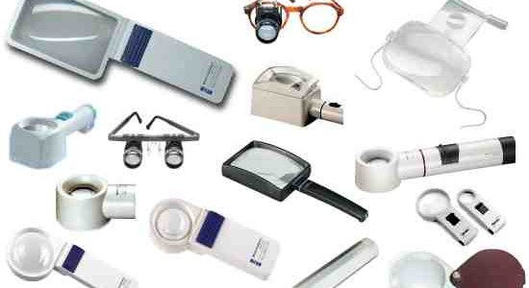
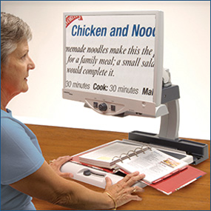

…Assistive Devices for Communication…
Devices to maximise use of residual vision
  Strong convex lens
  Print / text / visual magnifiers
  Electronic magnifiers

Slide 13



…AAC Devices & Practices…
Verbal Expression with Auditory and/or Visual Reception
  Speech Reading (of articulator movements as well facial expressions)
Manual Communication with visual reception
VISION

Slide 14


…AAC Devices & Practices…
Manual Expression with Visual Reception…
  Finger Spelling
  Gestures/Signs

Slide 15
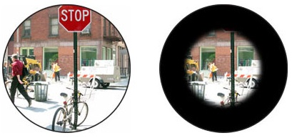
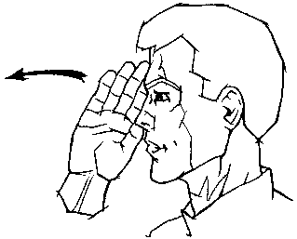
…AAC Devices & Practices…
Manual Expression with Visual Reception…
  Sign language
  Visual-frame signing (for persons with limited field of vision)

Slide 16
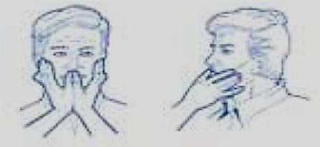
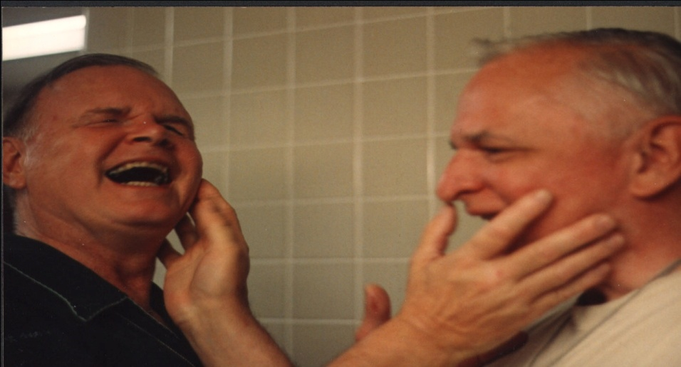
…AAC Devices & Practices…
Speech with Tactual Reception
  Tadoma

Slide 17
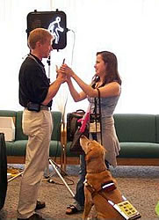
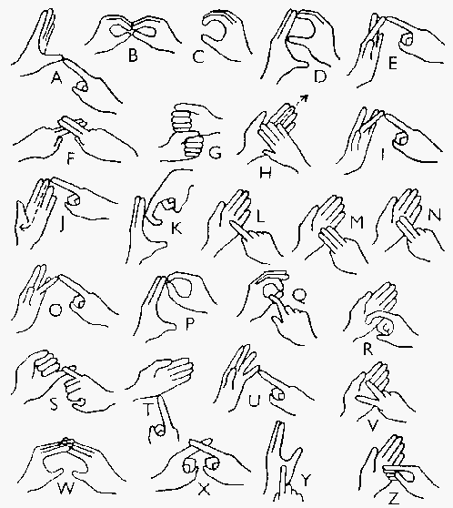
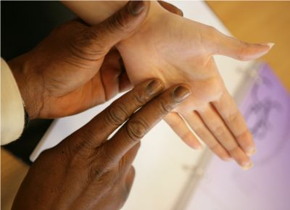
…AAC Devices & Practices…
Manual Expression with Tactile Reception
  Adapted Signs: Tactile Sign Language, Body Signs
  Deaf-Blind Alphabet /
  Tactile finger spelling

Slide 18

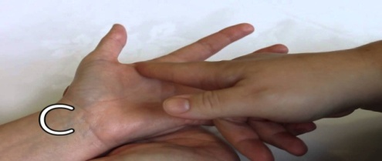
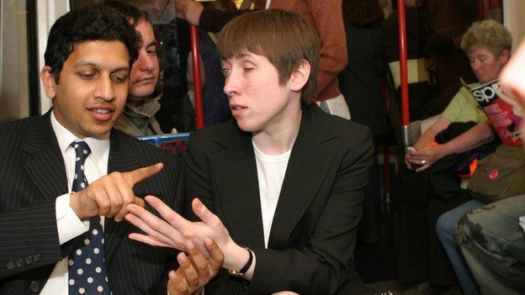
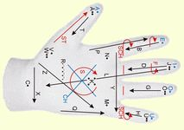
…AAC Devices & Practices…
Manual Expression with Tactile Reception
  Print on Palm
  Palm Alphabets

Slide 19
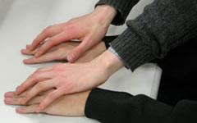
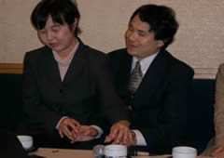

…AAC Devices & Practices…
Manual Expression with Tactile Reception
  Finger Braille
    Developed in Japan – to use 6 finger tips to represent braille code

Slide 20
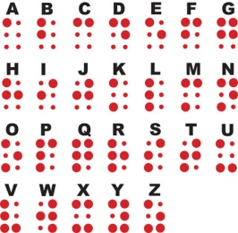
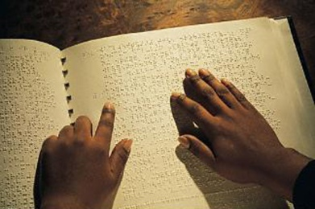
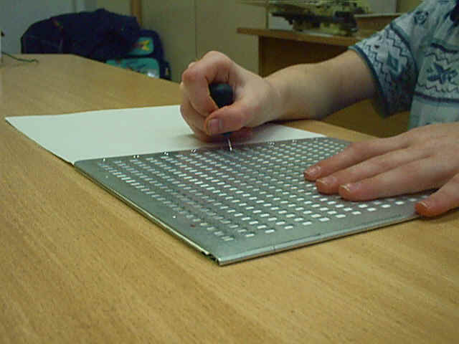
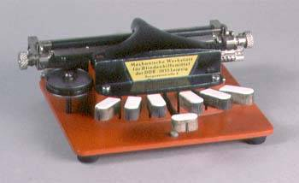
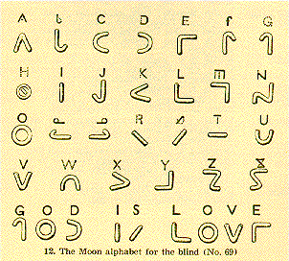
…AAC Devices & Practices…
Tactile (substitution for text / written communication)
  Braille
    Code involving combination of 6 raised dots – with devices for manual scripting & typing
  Moon Code
    Embossed letters very similar to printed letters (easy for individuals with acquired conditions to learn later in life)

Slide 21
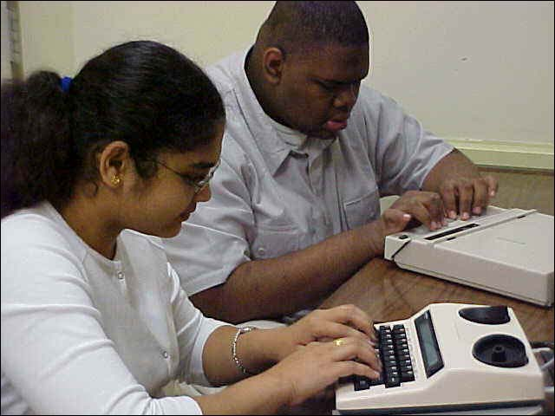
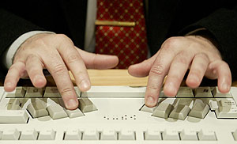
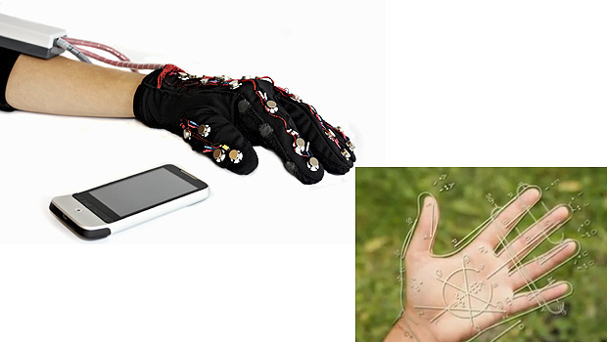
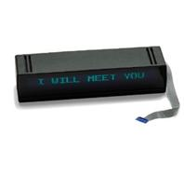
…AAC Devices & Practices…
… Electronic Devices…
  Devices/Software to convert –
    Braille/other tactile input to speech/text output
    Speech/text input to braille/tactile output
I am going home

Slide 22
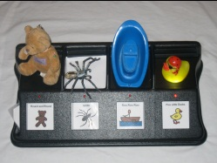
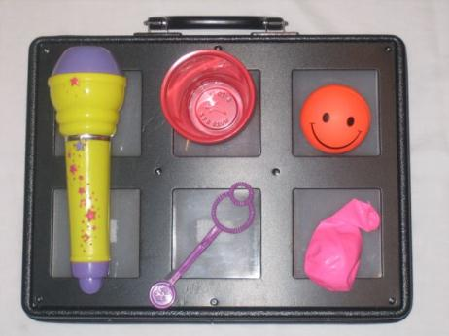
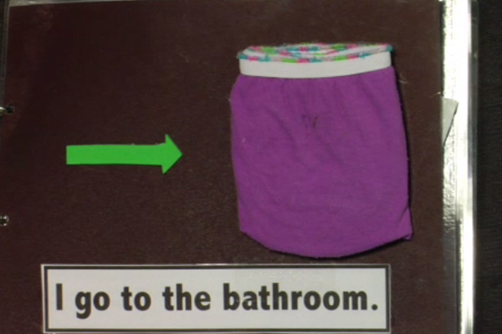
…AAC Devices & Practices…
Object / Tangible Symbols & Cues

Slide 23
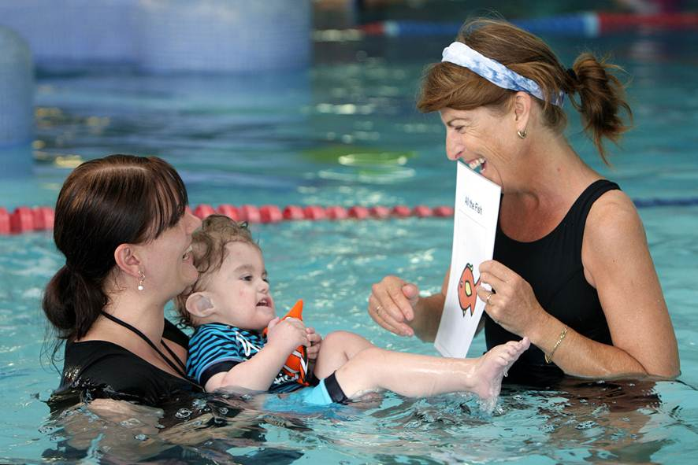
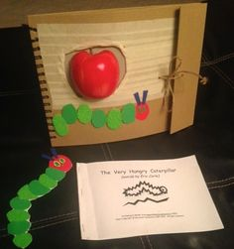
…AAC Devices & Practices
Use of Images
  Pictures, photos, other visual symbols
    Enlarged, textured and/or & raised relief

Slide 24
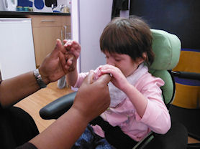
Enabling Communication Training
Individualised mode
Freedom of choice
Total communication approach
Meaningful & systematic training
Natural & incidental context
Positive & supportive attitude
Respectful treatment

Slide 25
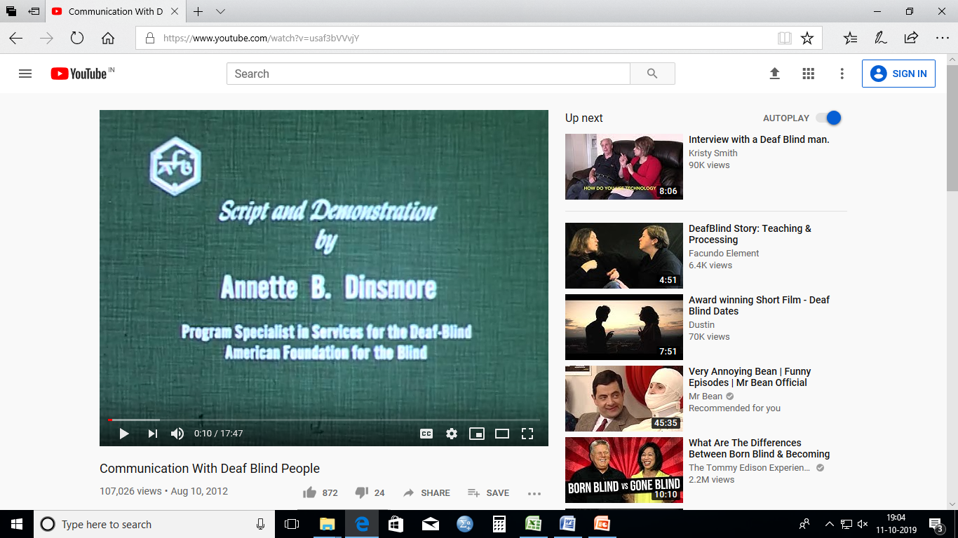
Enrich Your Exposure…
A short video by American Foundation for the Blind available at https://www.youtube.com/watch?v=usaf3bVVvjY will render a practical acquaintance communication for the Deaf-Blind

Slide 26

Further on…
The final concluding section of this unit will provide insights of what should be the focal aspects of educational habilitation if you as a special educator happen to manage a deaf-blind child …

